Slide 1
Automate Diagnosis & Consultant(adc)
(changing the way to presenting and detection of any diagnosis.)
PCS23-11
Domain : Full Stack + Machine Learning
Objective
The objective of developing monitoring systems is to reduce overall health care costs by reducing physical hospital visits, hospitalizations, and diagnostic testing procedure.
Team members:
Ayush Srivastava
1900290120029
Ankit Yadav 1900290120016
Under the Guidance of
Mr. Harsh Khatter
Assistant Professor Department of Computer Science

Slide 2
INTRODUCTION
The health problem is the gap between an acceptable or desirable health status and the present status.
This project is based on real time implementation as well as more informative and realistic.
It can be highly used in Medical Diagnosis and understanding the different feasibilities of model.

Slide 3
PROBLEM STATEMENT
In such unprecedented times, with a fragile healthcare infrastructure, the medical facilities for people are scarce and even fewer for people with special needs. The healthcare sector got so pre-occupied with Covid-19 cases that people with other ailments didn't even get a chance to avail medical assistances. So, We are here to present a model to mitigate the scarcity of facilities and the lack of medical management.

Slide 4
SOLUTION
Integration of clinical decision support with computer-based patient records could
Reduce medical errors.
Enhance patient safety.
Decease unwanted practice variation.
Improve practice outcome
which can help significantly improve the quality of clinical decisions using the data mining modelling technique.
Integrate doctors and patients via interacting and user-friendly interface so that Patient can easily utilize in emergency situations.
There are three primary goals of this model tend to be prediction, description, and presentation.

Slide 5
METHODOLOGY
There are three primary goals of data mining tend to be prediction, description, and presentation.
Prediction involves some variables or fields in the dataset to predict unknown or future values of other variables of interest.
Description focuses on finding patterns describing the data that can be interpreted by humans.
Presentation plays an important role to easily understandable to humans ie, augmented reality.

Slide 6
Model Module
There are Four Module in our model.
Doctor module
Patient Module
Lab Module
Admin Module

Slide 7
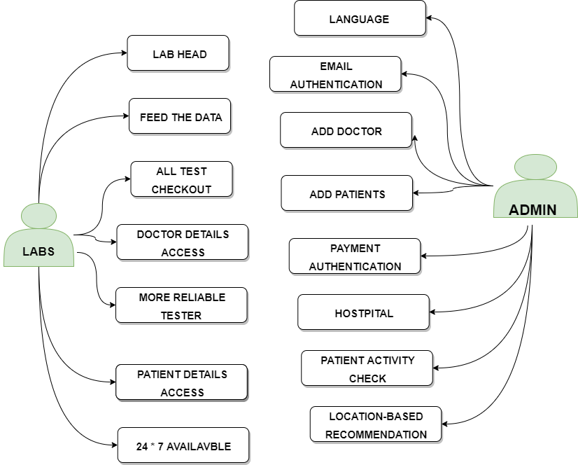
USE
CASE
DIAGRAM

Slide 8
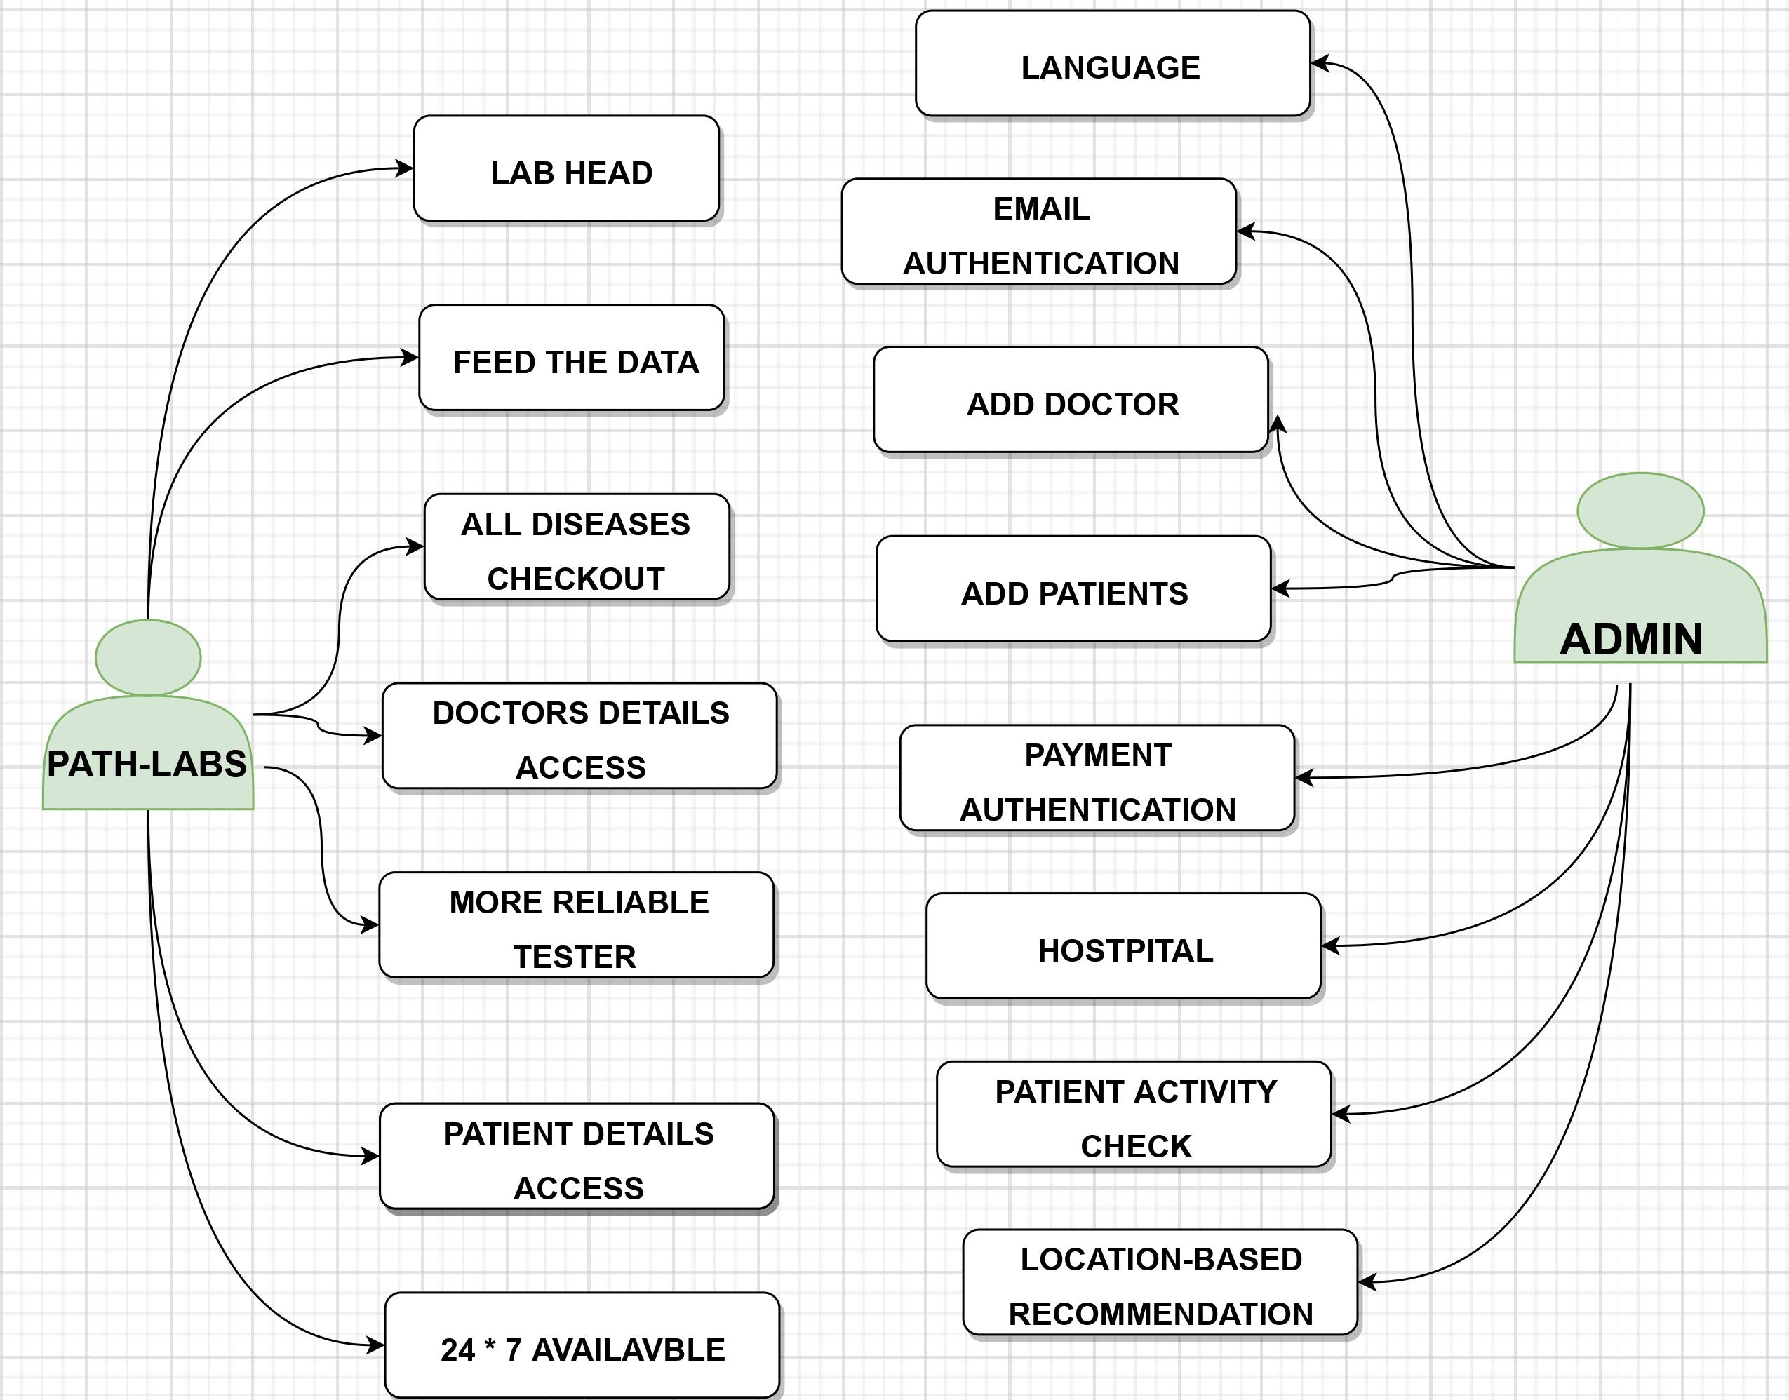
USE
CASE
DIAGRAM

Slide 9
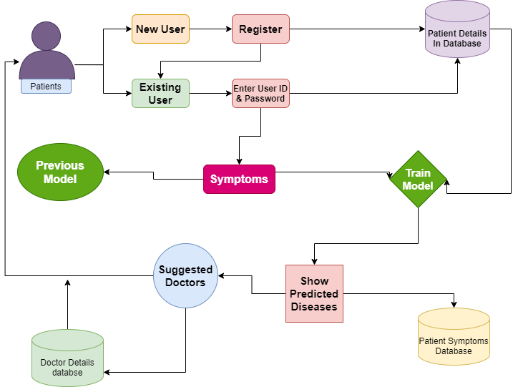
Patient
Module

Slide 10
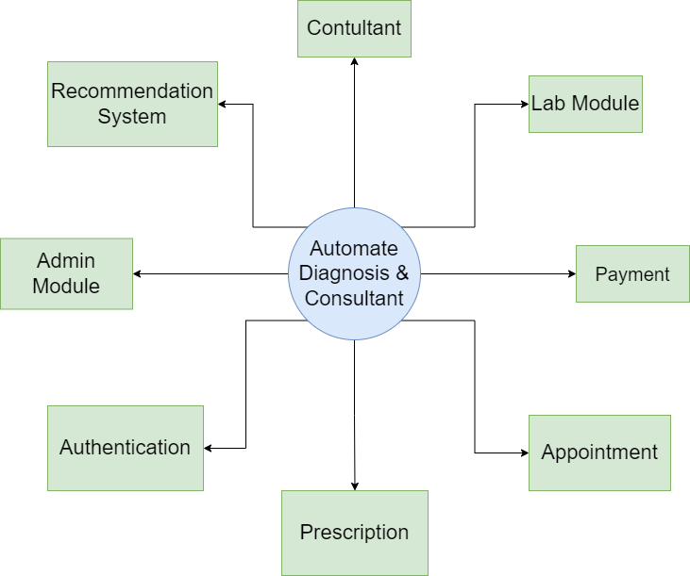
0-Level Data Flow Diagram

Slide 11
Technology Stack
Web Development
VS Code, HTML, CSS, ReactJS, Django etc.
Augmented Reality
Unity, Vuforia SDK, AR Core, A Frame, JDK, Augmented Reality integrated with Machine Learning
Machine Learning
Anaconda, Jupyter Notebook, EDA,Data Collection, Cleaning, Visualisation, NumPy, Pandas, Seaborn, SciPy, Matplotlib, Pandas, Sklearn Libraries, ML Algorithms.

Slide 12
Social Impact Analysis
Integration of clinical decision support with computer-based patient records could reduce medical errors, enhance patient safety.
It deceases unwanted practice variation and improve practice outcome which can help significantly improve the quality of clinical decisions.
Reduce disease identification time and start treatment expeditiously.
Reduce the cost of medical tests & by providing initial diagnostics in time that reduce huge amount of burden on patient’s family.

Slide 13
OUTCOME OF THE PROJECT
Research Paper
Patent
Website

Slide 14

Literature Review of the
Research Paper

Slide 15
Machine learning techniques for classification of diabetes and cardiovascular diseases
Machine learning methods are playing an increasingly important role in data analysis because they can deal with massive amounts of data. In fact, the more data the better. Most machine learning methods construct hypotheses from data. our growing abilities to store large amounts of data in rapid-access computer memories and to compute with these data has enabled techniques that store and use all the data as they are needed.
These insights yield connections between deep learning and diverse physical and mathematical topics, including random landscapes, spin glasses, jamming, dynamical phase transitions, chaos, Riemannian geometry, random matrix theory, free probability, and nonequilibrium statistical mechanics. Indeed, the fields of statistical mechanics and machine learning have long enjoyed a rich history of strongly coupled interactions, and recent advances at the intersection of statistical mechanics and deep learning suggest these interactions will only deepen going forward.

Slide 16
Supervised learning & Unsupervised Learning
ML methods that aim to learn a function from a given training data set constitute the second main approach, called supervised learning. Two main criteria for the success of supervised learning algorithms are prediction and generalization. The learned function should be able to successfully predict the output for data other than in the training set used. At the same time, it should act as a model that captures the underlying characteristics of the training data and generalize to new data points.
Supervised ML techniques offer an invaluable set of formalized computing methods to develop computer-assisted detection, analysis, and decision systems for network security. These methods have been successfully applied to a wide variety of fields ranging from image recognition, speech processing, and data mining. the opposite behaviour is called overfitting where the function describes the training data perfectly but has poor predictive power. The performance of a supervised learning algorithm is quantitatively assessed using a test data set and cross-validation techniques.

Slide 17
Regression Techniques
Linear regression analysis is often used by life scientists. For example, the equation for the regression of one variable on another may suggest hypotheses about why the two variables are functionally related. More practically, regression can be used in situations where the dependent variable is difficult, expensive, or impossible to measure, but its values can be predicted from another easily measured variable to which it is functionally related. Logistic regression is an extension of linear regression. Rather than modeling a linear relationship between the independent variable x and the probability of the outcome, which is unnatural since it would allow predicted probabilities outside the range of 0–1, it assumes a linear (straight line).
A major advantage of logistic regression compared to other similar approaches like probity regression—and therefore, a reason for its popularity among medical researchers—is that the exponentiated logistic regression slope coefficient (e^{b}) can be conveniently interpreted as an odds ratio. The odds ratio indicates how much the odds of a particular outcome change for a 1-unit increase in the independent variable (for continuous independent variables) or versus a reference category.

Slide 18
Support Vector Machine in medical fields
Support Vector Machine is a supervised Machine Learning algorithm that can be used for both classification and regression challenges. However, it is mostly used in classification problems. In the SVM algorithm, we plot each data item as a point in n-dimensional space with the value of each feature being the value of a particular coordinate. Then, we perform classification by finding the hyper-plane that differentiates the two classes very well.
The SVM kernel is a function that takes low dimensional input space and transforms it to a higher dimensional space i.e., it converts not separable problem to separable problem. It is mostly useful in non-linear separation problems. Simply put, it does some extremely complex data transformations, then finds out the process to separate the data based on the labels or outputs you’ve defined.

Slide 19
Research and Analysis of the Front-end Frameworks and Libraries in E-Business Development
With web technology rapidly expands out in recent years, there is a significant trend that Hypertext Markup Language(HTML)5 turns into a worldwide web consortium and leads the front-end development to stand on the front stage of internet history. However, there are numerous front-end development frameworks and libraries such as React, Angular and Vue. How to select a suitable framework or library to establish the e-Business and reach out to maximize the user experience becomes a priority operation in web development. This paper starts with introducing an overview of the leading frameworks and libraries in the field of front-end development and examine each performance in web services.

Slide 20
A review and analysis of technologies for developing web Applications
Web applications tend to be multi-tiered by nature, with the most common structure being the three- tiered architecture. In its most common form, the three tiers are • Presentation layer: The presentation tier is the front end layer in the 3- tier system and consists of the user interface. This user interface is often a graphical one accessible through a web browser or web-based application and which displays content and information useful to an end user. The four big technologies in this layer are HTML, CSS, JavaScript and JQuery.The workflows by which the data and requests travel through the back end are encoded in a business layer. Scripting languages that are uses are ColdFusion, Ruby, WebObjects and Python.

Slide 21
Research on HTML5 in Web Development
The purpose of this study was about HTML (Hypertext Markup Language) is the code that is used to structure a web page and its content. It is the building block of a website. HTML5 is the next major revision of the HTML standard superseding HTML 4.01, XHTML 1.0, and XHTML HTML5 is a standard for structuring and presenting content on the World Wide Web. HTML5 is a cooperation between the World Wide Web Consortium (W3C) and the Web Hypertext Application Technology Working Group (WHATWG). The lesson was about new tags that are introduced in HTML5. With the development of HTML5 it has wide range of applications in multimedia direction. It can play audio and video and supports animations from the browser without the need of the proprietary technologies. HTML5 introduces a number of new elements and attributes that can help you in building modern websites.

Slide 22
Challenges in Android Application Development
The following are the challenges faced by the Android App developers The most common challenge is to set the properties of app for different devices with different screen sizes, resolution etc. There are many versions of each android device and while releasing the app, version specific details need to be checked this makes the task very critical. Currently, the Development Environment does not have enough tools for testing. There is a need of testing techniques for the Android Platform. Also debugging features must be made available. Sometimes different devices have different capabilities in terms of software support like some browsers has poor support for HTML5.

Slide 23
REFERENCES
V. S. Pendyala and S. Figueira, "Automated Medical Diagnosis from Clinical Data," 2017 IEEE Third International Conference on Big Data Computing Service and Applications (BigDataService), 2017, pp. 185-190, doi: 10.1109/BigDataService.2017.14.
F. Santos, F. Silva and P. Georgieva, "Automated Diagnosis of Skin Lesions," 2020 IEEE 10th International Conference on Intelligent Systems (IS), 2020, pp. 545-550, doi: 10.1109/IS48319.2020.9200090.
V. Datla et al., "Automated clinical diagnosis: The role of content in various sections of a clinical document," 2017 IEEE International Conference on Bioinformatics and Biomedicine (BIBM), 2017, pp. 1004-1011, doi: 10.1109/BIBM.2017.8217794.
F. Ertam and G. Aydın, "Data classification with deep learning using Tensorflow," 2017 International Conference on Computer Science and Engineering (UBMK), 2017, pp. 755-758, doi: 10.1109/UBMK.2017.8093521.
H. Božiković and M. Štula, "Web design — Past, present and future," 2018 41st International Convention on Information and Communication Technology, Electronics and Microelectronics (MIPRO), 2018, pp. 1476-1481, doi: 10.23919/MIPRO.2018.8400266.
D. S. Blyth, "Web page design for HTML (and friends)," IPCC 96: Communication on the Fast Track. IPCC 96 Proceedings, 1996, pp. 89-103, doi: 10.1109/IPCC.1996.552585
N. Sandhya and K.R. Charanjeet, "A review on Machine Learning Techniques", International Journal on Recent and Innovation Trends in Computing and Communication, pp. 395-399, 2016, ISSN 2321-8169.
D. Fagella, 7 Applications of Machine Learning in Pharma and Medicine, 2017, [online] Available: https://goo.gl/IS1R5k.

Slide 24
H. Ran, W. Zhuo and X. Jianfeng, "Web Quality of Agile Web Development," 2009 IITA International Conference on Services Science, Management and Engineering, 2009, pp. 426-429, doi: 10.1109/SSME.2009.112.
S. Drobi, "Play2: A New Era of Web Application Development," in IEEE Internet Computing, vol. 16, no. 4, pp. 89-94, July-Aug. 2012, doi: 10.1109/MIC.2012.84.
H. Sugimura et al., "Development of immersive display system of web service in living space," 2014 IEEE 3rd Global Conference on Consumer Electronics (GCCE), 2014, pp. 49-50, doi: 10.1109/GCCE.2014.7031106.
J. Siddiqi, B. Akhgar, A. Gruzdz, G. Zaefarian and A. Ihnatowicz, "Automated Diagnosis System to Support Colon Cancer Treatment: MATCH," Fifth International Conference on Information Technology: New Generations (itng 2008), 2008, pp. 201-205, doi: 10.1109/ITNG.2008.62.
P. Ongsulee, "Artificial intelligence, machine learning and deep learning," 2017 15th International Conference on ICT and Knowledge Engineering (ICT&KE), 2017, pp. 1-6, doi: 10.1109/ICTKE.2017.8259629.
R. Chellappa, S. Theodoridis and A. van Schaik, "Advances in Machine Learning and Deep Neural Networks," in Proceedings of the IEEE, vol. 109, no. 5, pp. 607-611, May 2021, doi: 10.1109/JPROC.2021.3072172.
B. Alić, L. Gurbeta and A. Badnjević, "Machine learning techniques for classification of diabetes and cardiovascular diseases," 2017 6th Mediterranean Conference on Embedded Computing (MECO), 2017, pp. 1-4, doi: 10.1109/MECO.2017.7977152.

